Slide 1

Machine learning is not easy
Notes:
DARPA challenge

Slide 2
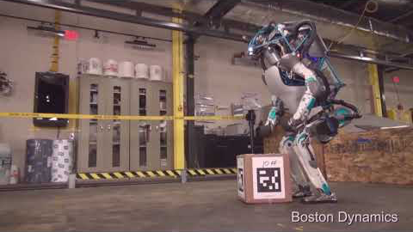
But progress is made ...
Notes:
Video der neueren Bots
Oder gibt es vielleicht sogar ein neueres Video mit dem Fortschritt über die Zeit?

Slide 3
Lecture Foundations of Artificial Intelligence Part 8 – Machine Learning 1
Torsten Zesch
Language Technology Lab
Universität Duisburg-Essen
Notes:
Willkommen zur Vorlesung Grundlagen der künstlichen Intelligenz, oder auch Wissensrepräsentation.

Slide 4
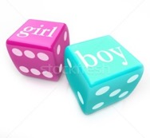
Recap last lecture
Agents need to model uncertainty by using probabilities.
Conditional probability: P (A | B)
The probability of A when we have the knowledge that B is true.
Bayes rule:
$$P\left(A | B\right)=\frac{P(B|A)∗P(A)}{P(B)}$$
Don’t rely on your naïve judgement → Model the problem.

Slide 5

Any other open questions?

Slide 6
Today
Machine Learning
Motivation

Slide 7
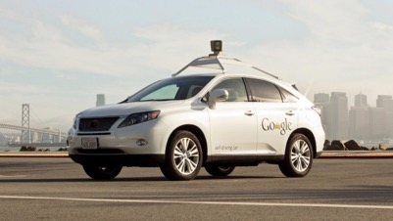
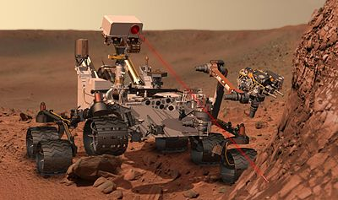
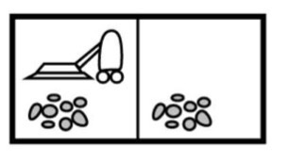
Why learning?
Agents should be able to decide how to act in unknown situations.
So far: lookup table
But: we cannot anticipate every possible situation
Machine Learning is about learning a very compact representation of the table-lookup-agent that also applies to unseen data.

Slide 8
How can our agent learn?
By going through extensive training!
Show the agent example situations and tell it which reaction is desired.
Learn commonalities between situations that require the same reaction.
instances
gold label

Slide 9

Learning from too few instances

Slide 10
Outline
Machine learning: Overview
Supervised learning
Features
Evaluation
Notes:
10

Slide 11
Today
Machine Learning
Overview

Slide 12
Learning a model
Goal of training: build a model of the problem space
How good is the model?
Notes:
Dieses Weltmodel erklärt auch viele Phänomene: good enough? Kommt auf den Task an. Wenn wir von Europa möglichst schnell nach Indien reisen wollen und in Amerika ankommen (Columbus), brauchen wir ein Modell, das uns das besser erklärt.
Ja, aber was sagt uns das?

Slide 13
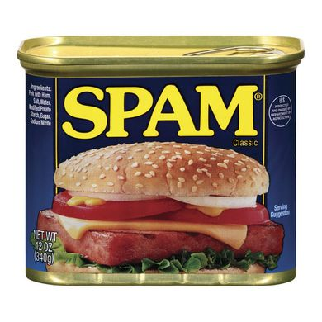

A Sample Problem: Spam Classification
Hello, Do you want free printr cartriges? Why pay more when you can get them ABSOLUTELY FREE! Just...
Hi Anna,
how is it going in with the new apartment? I just wanted to invite you and John for my birthday party next weekend...
Spam or not?
Notes:
Woher wissen wir, dass das Spam ist? = features

Slide 14
Getting the Data
Our data should be as close as possible to the “real” data, i.e. the data we want to use the classifier for.
has to contain instances of all classes (in our example: we need both spam and normal email)
find existing dataset (often not a perfect fit)
collect own data (very time-consuming)
you might have to adjust your problem definition to get representative data
The instances have a known outcome (gold label, class).
often manually annotated (Is this email spam or not?)
We need a lot of them to be able to learn something. The more the better.
How much exactly depends on the problem.
performance
# training instances

Slide 15
Training a Model
Classifier learns to associate knowledge about an instance (e.g. email) with a label (e.g. spam) → supervised learning (There is also the case of unsupervised learning, where we have lots of data but without labels.)
Determine the best label for an instance: select a label, so that P(label|instance) is maximal
Instances need a computationally readable representation of the known facts of that instance → features

Slide 16
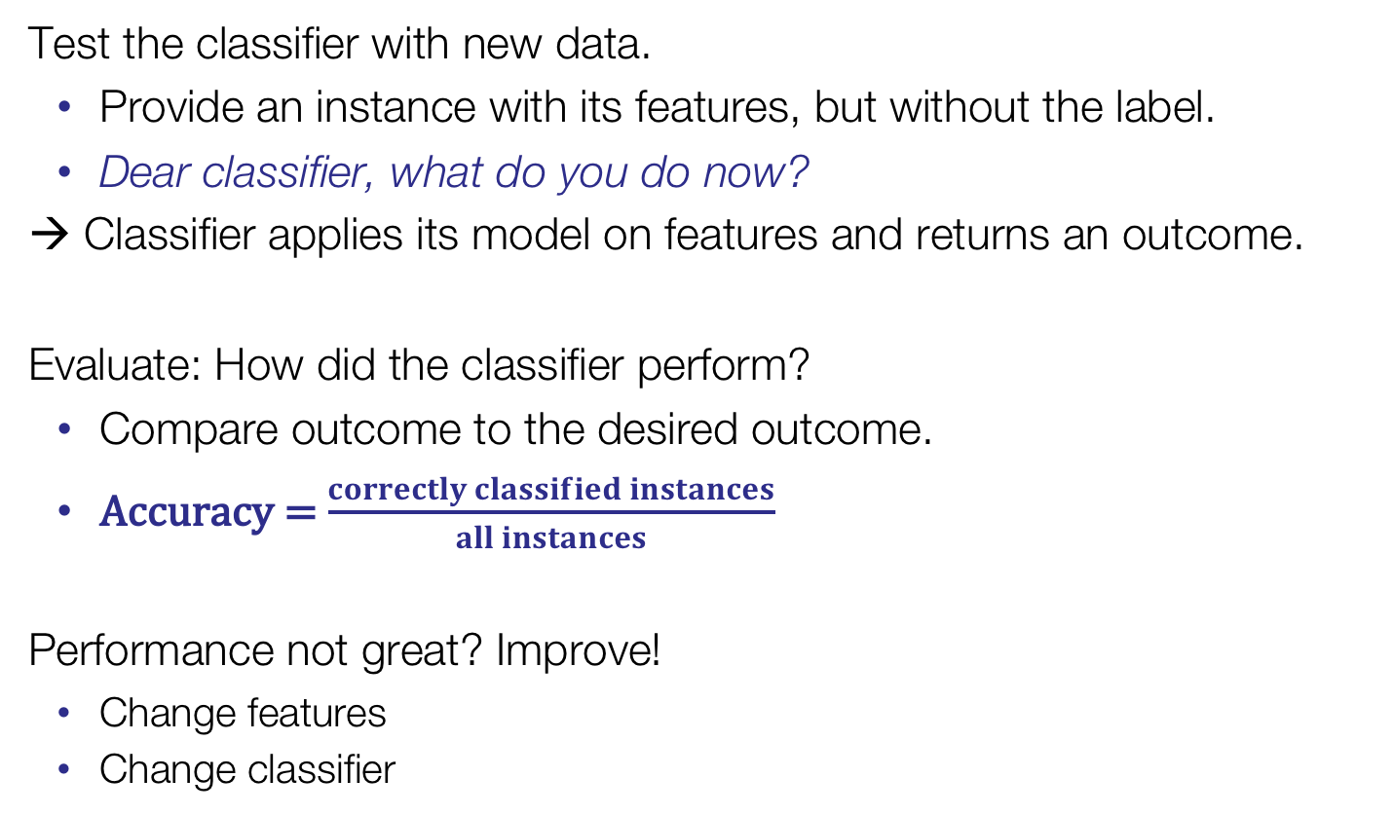
How Good is my Model?
Test the classifier with new data.
Provide an instance with its features, but without the label.
Dear classifier, what do you do now?
→ Classifier applies its model on features and returns an outcome.
Evaluate: How did the classifier perform?
Compare outcome to the desired outcome.
Accuracy = $\frac{correctly classified instances}{all instances}$
Performance not great? Improve!
Change features
Change classifier

Slide 17
The Machine Learning Cycle
Get data
Train (80%)
Dev
(10%)
Test
(10%)
extract features
evaluation
tune
final
evaluation
+ error analysis
train
Model
apply
apply

Slide 18
Outline
Machine learning: Overview
Supervised learning
Features
Evaluation
Notes:
18

Slide 19
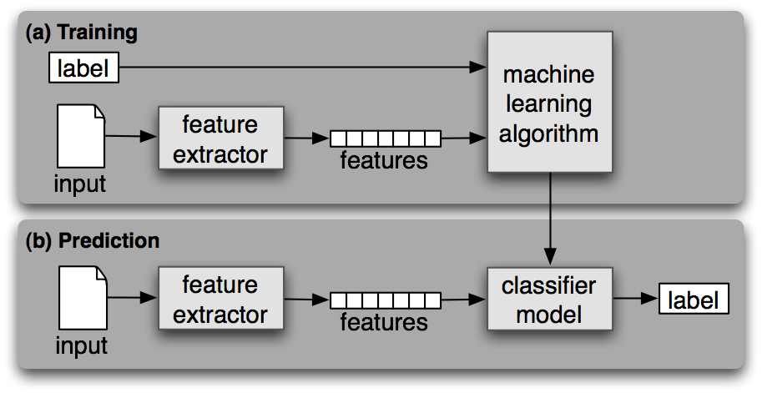
Supervised classification
A classifier is called supervised if it is built based on training corpora containing the correct label for each input
Supervised classification framework

Slide 20
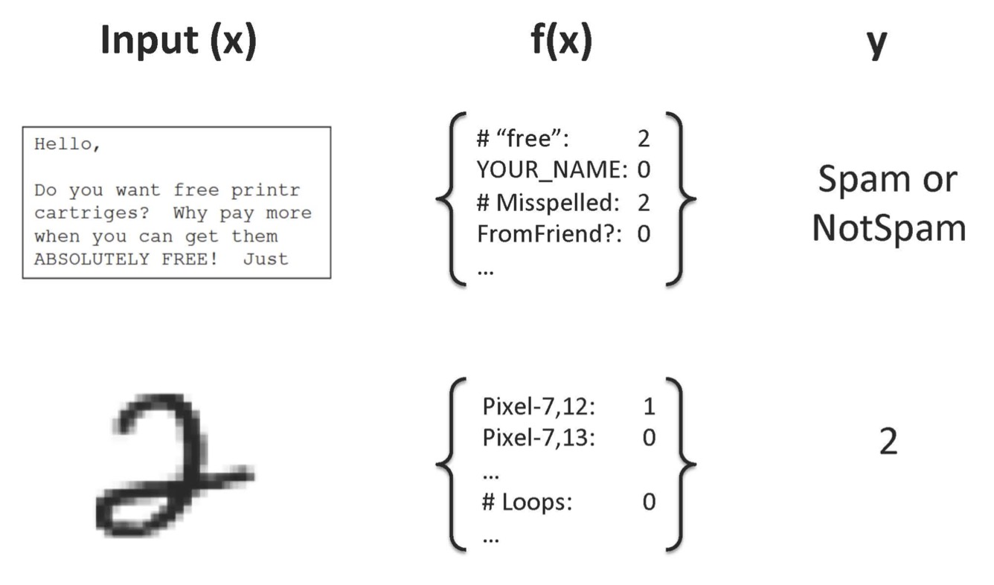
Supervised classification
feature representation

Slide 21
Supervised classification
feature representation

Slide 22
Supervised learning: formal
Given: Training examples x_{i} with gold labels y_{i}
System task: Learn function f(x) = y that approximates the data
{(x₁, f(x₁)), (x₂, f(x₂)), ...., (x_{n}, f(x_{n}))}
The learned function should be able to predict y’ for x’ which has not been seen in the training data.

Slide 23
Example: Predict Income Based on Age
Age is the only feature we use → linear regression
y = f(x) = wx + b
w: slope, b: intercept → the parameters of the model
More features?
Not a very good fit
(even for the training data)

Slide 24
Example: “Play tennis” Prediction
Attributes / Features
outlook {sunny, overcast, rainy}
temperature {hot, mild, cool}
humidity {high, normal}
windy {true, false}
play Tennis{P, N}
x¹ x² x³ x⁴ f(x)

Slide 25
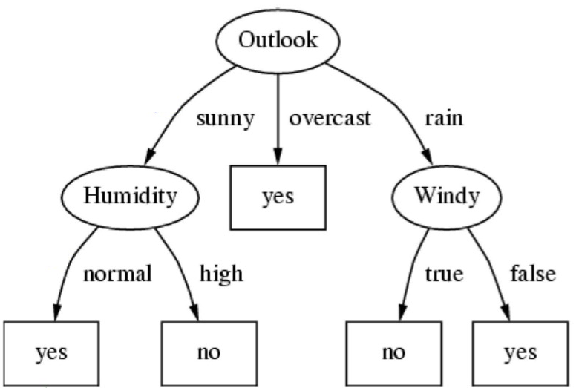
Preview: Classifier
Notes:
Next lecture

Slide 26
Preview: Classifier
More on how to build a decision tree: next week
Now, make a prediction for a new event: sunny, mild temperatures, normal humidity, no wind → ???
Notes:
Next lecture

Slide 27
Training data
Experience E in the form of examples that are characteristic of the whole input space
representative sample
independent and identically distributed (no bias in selection / observations)
Many names:
Experience / Instances / Examples / Samples / Training data points
Instances have to be comparable to each other
How to obtain training data depends on the task …

Slide 28
Outline
Machine learning: Overview
Supervised learning
Features
Evaluation
Notes:
28

Slide 29
Machine Learning Features

Slide 30
Feature Types
Predict Income
Feature
Level of education
Field of work
Income of parents
School grade
Height
Weight
Gender
...
Type
nominal
nominal
numeric (or ordinal?)
nominal
numeric
numeric
binary (nominal?)
...
Example
college
computer science
2452€ (1000-2500€)
1.4
174
83
0 (Cis Male)
...

Slide 31
Representing knowledge
The knowledge needs to be represented in a computationally readable format.
Represent every instance x as a vector of features: [x₁,x₂,x₃,...,x_{n}]
Common feature types:
binary
nominal
ordinal
numeric
Many algorithms do not work well with nominal features → transform them into binary features.
Field of work: isEngineer: 1, 0, isTeacher: 1, 0, ...
This can lead to sparse features. sparse: 0 for almost all instances isEecotrophologist, isAstronaut, ...
Notes:
Sparse features sollte man eher vermeiden. Sie sind zwar oft sehr aussagekräftig, aber in der Mehrzahl der Fälle nicht besonders hilfreich.
z.B. Unterscheidung Mann/Frau, Feature: über 2m groß

Slide 32
Example: Multiple linear regression
y = f(x) = wx + b
Represent every x as a vector of features: [x₁,x₂,x₃,...,x_{n}]
y = w₁x₁+ w₂x₂+ ... + w_{n}x_{n}+ b
Parameter w is now a vector [w₁,w₂,w₃,...,w_{n}].
Problems:
Linear regression only works well if y is a continuous numerical variable
Most real-world problems do not have linear relationships

Slide 33
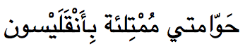
Guess the Language
我的氣墊船裝滿了鱔魚
私のホバークラフトは鰻でいっぱいです
내 호버크라프트는 장어로 가득 차 있어요
โฮเวอร์คราฟท์ของผมเต็มไปด้วยปลาไหล
Tàu cánh ngầm của tôi đầy lươn
Gari langu linaloangama limejaa na mikunga
Mia kusenveturilo estas angiloplena
Mi aerodeslizador está lleno de anguilas
Il mio aliscafo è pieno di anguille
Ilmatyynyalukseni on täynnä ankeriaita
Моё судно на воздушной подушке полно угрей
Mój poduszkowiec jest pełen węgorzy
Moje vznášedlo je plné úhořů
Benim hovercraft yılan balığı dolu
Το Χόβερκράφτ μου είναι γεμάτο χέλια
Chinesisch/Mandarin
Japanisch
Koreanisch
Thai
Vietnamesisch
Swahili
Esperanto
Spanisch
Italienisch
Finnisch
Russisch
Polnisch
Tschechisch
Türkisch
(Neu-)Griechisch
Hebräisch
Arabisch (MSA)
Notes:
LIVE: erratene Sprachen an Tafel mitschreiben
Alle Sätze bedeuten: “My hovercraft is full of eels” (Monty Python)
http://www.omniglot.com/language/phrases/hovercraft.htm (with speech samples)
Woran erkennt man das?

Slide 34
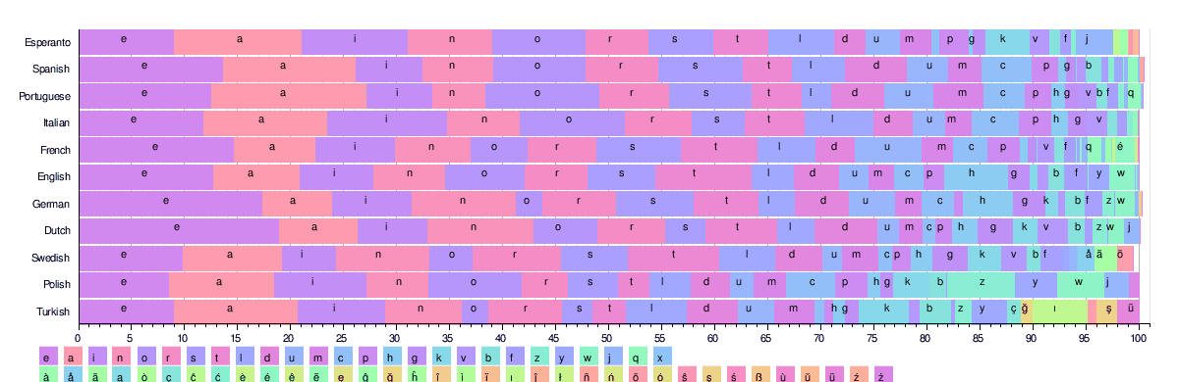
Possible features for language identification?
Character set
Special words
Length of tokens
Distribution of characters / character bigrams
Notes:
Wann machen wir das selbst?

Slide 35
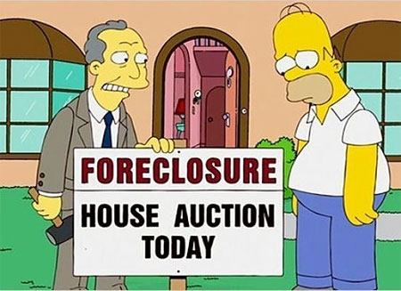
Example: Credit risk assessment
Possible Features
income range
debt load
employment history
real estate properties
criminal record
city of residence
…

Slide 36
Example: Weather forecast
Possible Features
Yesterday’s weather
Current temperature
Current humidity
Air pressure
…
http://www.orniwetter.info/wp-content/uploads/2016/03/20160327_Modellwetter.gif

Slide 37
Representing features
Predicting wine quality

Slide 38
Enrich the representation
Surface features
typesetting of label, length of name, color of wine
External knowledge
look up soil quality of wine region
Relations between features
ratio between residual sugar and alcohol
Relations between instances
price of earlier vintage from the same vineyard
Preprocessing
pour the wine in a glass and note down adjectives for aroma
Analyze sub-parts
properties of grapes that form part of the wine blend
Good features are often highly domain-specific.
Notes:
Diskutieren, wie sehen die Features für Sprachverarbeitung oder Bildverarbeitung aus?

Slide 39
So, more features is better?
When learning a classifier, every feature introduces a parameter that has to be learned.
More parameters → more training data required
Did we introduce too many features for the available data?
Further problems
Some algorithms assume features to be independent. Dependent features lead to deficient models.
Some algorithms only deal with binary (numeric, nominal) features.
Complex features take long to compute.
Sparse features usually don’t help much.
→ perform feature selection on the training data
Notes:
Beispiel: Was sind dependent features?

Slide 40
Feature Selection
A good feature is able to split the instances into two (or more) parts so that each part is as pure as possible → ideally, each part contains only examples of a single class
Entropy: measure of impurity (also: unpredictability, unorderedness, average information content, surprise)
x: male
x: female
x
x
x
x
x
x
x
x
x
x
x
x
vs.
x
x
x
x
x
x
x
x
x
x
x
x
x
x
x
x
x
x
x
x
x
x
x
x
x
x
x
x
x
x
x
x
x
x
x
x
feature 1: true
feature 1: false
feature 2: true
feature 2: false
Notes:
[an Tafel ein Beispiel machen – Kreis mit Plus/Minus Instanzen, wie am besten splitten?]
information content/surprise: wenn der Container unsortiert ist (50/50 split) und wir ziehen blind ein Element heraus, wissen wir vorher nicht, was wir bekommen werden → Informationsgehalt bzw Überraschung sind daher hoch. Wenn der Container sortiert ist und nur eine Klasse enthält, wissen wir schon was wir bekommen werden: information/surprise sind daher niedrig.
Hier muss noch ein Beispiel auf die Folien

Slide 41
Entropy for a feature value
Entropy H(S): measure of impurity in a set S of instances with respect to gold labels i
$$Entropy\left(S\right)=−\sum_{i=1}^{n}{p\left({goldlabel}_{i}\right)∗ log{p\left({goldlabel}_{i}\right)}}$$
Labels = {female, male}, S₁ = {has-long-hair=true}
$Entropy\left(S_{1}\right)=−p\left(female\right)∗log p\left(female\right)−p\left(male\right)$ $∗log p\left(male\right)$
$= −\frac{15}{18}∗\log{\frac{15}{18}} −\frac{3}{18}∗\log{\frac{3}{18}}$ = 0.65
S₂= {has-long-hair=false}
$Entropy\left(S_{1}\right)=−p\left(female\right)∗log p\left(female\right)−p\left(male\right)$ $∗log p\left(male\right)$
$= −\frac{5}{22}∗\log{\frac{5}{22}} −\frac{17}{22}∗\log{\frac{17}{22}}$ = 0.77
has-long-hair | TRUE | FALSE
Female | 15 | 5
Male | 3 | 17
Notes:
binärer log

Slide 42
Entropy: interpretation
Maximal value if labels are equally distributed in S
Minimal value if only one label left in S
Notes:
Begriffe noch mal aufnehmen: Unordnung, Überraschung
Wenn mein Vater sagt: ich muss mal gerade was aus dem Keller holen, dann habe ich keine Ahnung womit er zurück kommt, weil da so viel unterschiedliches Zeug liegt. Wenn er etwas aus der Besteckschublade holt, dann ist die Überraschung nicht so groß, weil da nur Messer, Gabeln und Löffel drin liegen.

Slide 43
Information of a feature
Information = weighted average entropy over all feature values k
$$I\left(feature\right)=\sum_{k=1}^{n}{w_{k}∗Entropy(S_{k}) }$$
weighted by size of part: $w_{k}=\frac{\left|S_{k}\right|}{\left|S\right|}$
Entropy(has-long-hair=true) = 0.65
Entropy(has-long-hair=false) = 0.77
Information(has-long-hair) = $\frac{18}{40}∗0.65+\frac{22}{40}∗0.77=0.72$
has-long-hair | TRUE | FALSE
Female | 15 | 5
Male | 3 | 17
Notes:
binärer log

Slide 44
Information Gain
The information gain of a feature is the change in information when applying this feature.
Information(Before) = $1 ∗Entropy\left(S\right)= −\frac{20}{40}∗\log{\frac{20}{40}} −\frac{20}{40}∗\log{\frac{20}{40}}$ = 1
Information(Feature) = $0.72$
InformationGain(Feature) = 1 – 0.72 = 0.28
has-long-hair | TRUE | FALSE
Female | 15 | 5
Male | 3 | 17
Notes:
binärer log
Wir haben gleich große Klassen: 20 Männer, 20 Frauen → das ist der Sonderfall, in der Regel ungleich große Klassen (berücksichtigen!)

Slide 45
Information Gain
The information gain of a feature is the change in entropy when applying this feature.
It can be used to automatically reduce the feature space to the most predictive features.
Filter-based feature selection:
apply a filter (e.g. information gain) on features
select only n-best
train new machine learning model
evaluate
Notes:
binärer log

Slide 46
Searching through the feature space
Wrapper-based feature selection:
apply a search algorithm (greedy, genetic,...) to find the best-performing subset of all possible feature subsets
computationally expensive
Feature selection is very (!) prone to overfitting. Apply carefully.
Correlated features can cause confusion.
Notes:
Das hier versteht man so nicht, das muss anders

Slide 47
Summary: Features
Different types: binary, nominal, ordinal, numeric
Surface features
External knowledge
Relations between features
Relations between instances
Preprocessing
Analyze sub-parts
Many features are highly domain- and task-specific.
Feature selection: entropy, information gain

Slide 48
Model
Development
Notes:
HIER PAUSE

Slide 49
Early evaluation
Evaluation: compare the predictions of the classifier with the gold labels.
Accuracy = $\frac{correctly classified instances}{all instances}$
Early evaluation: How well does the model learn?
Evaluation on the development set
Cross-validation
Early evaluation is useful for hyperparameter selection.
Danger of overfitting!

Slide 50
Cross-validation
k -fold cross-validation: method to evaluate the model on the training set
Partition the training set into k parts of equal size.
Train the model on all k-1 parts and test it on the k^{th} part. → fold 1
Repeat this so that each part forms part of the test set once. → k folds
Collect the predictions for all folds and calculate the evaluation score.
n = # of instances in training data
If k = n → leave-one-out cross-validation

Slide 51
5-fold cross-validation animation
X = {X₁, X₂, X₃, X₄, X₅}
X₁
X₂
X₃
X₄
X₅
X₁
Test
Result: combine the predictions from each run and calculate the evaluation score once.
Train
Notes:
51
NIcht! Jedes Mal den score berechnen und dann den average berichten!

Slide 52
Problems with cross-validation
Class labels are not equally distributed
stratified cross-validation: the folds are selected so that each fold contains roughly the same proportions of class labels.
”Natural units” are split over folds.
e.g., sentence classification: sentences from the same document are split over different folds.
→ make sure to keep document boundaries intact.
Notes:
ZUm Beispiel 1 Dokument = 1 Fold

Slide 53
Test set
When we have fixed all parameters of the model, we can finally evaluate on the test set.
The test set should be representative for the data.
Comparable class distribution
The test set needs to be big enough.
Commonly: 10% of whole data set

Slide 54
Evaluation
Metrics
Notes:
Beispiel für Business Analytics Studenten

Slide 55
Accuracy
$$= \frac{TP+TN}{TP+FP+TN+FN}$$
Accuracy = $\frac{correctly classified instances}{all instances}$
Confusion matrix:
In most tasks, the classes are imbalanced.
Spam classification: only 5% of mails are spam.
Classify everything as “not spam” → spam detector with 95% accuracy
The other way around would be even worse.
http://blog.exsilio.com/all/accuracy-precision-recall-f1-score-interpretation-of-performance-measures/
Notes:
Anderes Beispiel?

Slide 56
Class-imbalance Problem
Example: Language Identification
99 out of 100 texts are English.
Accuracy of 99% when always outputting “English”.
2 out of 100 texts are English.
Accuracy of 2% when always outputting “English”.
Scenario A
Scenario B

Slide 57
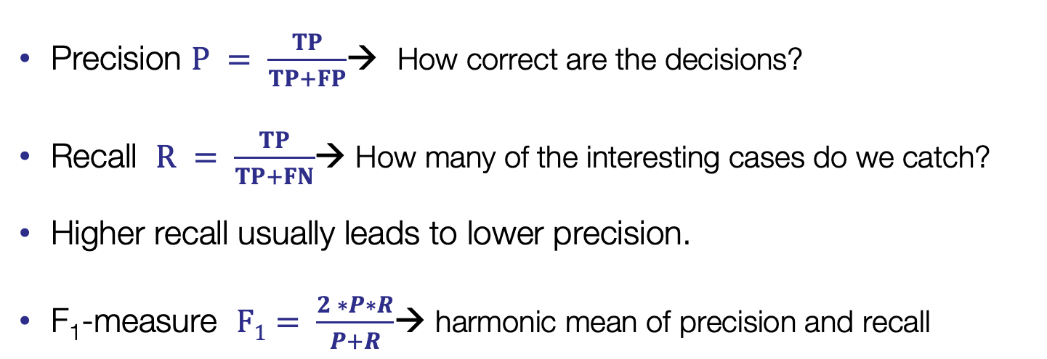
Precision, Recall, F₁-measure
Precision $P = \frac{TP}{TP+FP}$→ How correct are the decisions?
Recall $R = \frac{TP}{TP+FN}$→ How many of the interesting cases do we catch?
Higher recall usually leads to lower precision.
F₁-measure $F1= \frac{2 ∗P∗R}{P+R}$→ harmonic mean of precision and recall
http://blog.exsilio.com/all/accuracy-precision-recall-f1-score-interpretation-of-performance-measures/
Notes:
Recall = Sensitivity
Beispiel: Aids-Test
Ob Präzision oder Recall wichtiger ist, hängt von der Anwendung ab, in der Regel will man was dazwischen - > F1-measure

Slide 58
Example: Accuracy
gold = [1,1,1,1,2,2,2,3,3,3]
test = [1,1,2,3,2,1,1,3,2,2]
| 1 2 3 |
--+-------+
1 |<2>1 1 |
2 | 2<1>. |
3 | . 2<1>|
--+-------+
(row = reference; col = test)
Accuracy?
(2+ 1+ 1)/10 = 40%
Notes:
.pp steht vermutlich für „pretty print“ (Dokumentation ist nicht sehr ausführlich an der Stelle)

Slide 59
Example: Precision
gold = [1,1,1,1,2,2,2,3,3,3]
test = [1,1,2,3,2,1,1,3,2,2]
| 1 2 3 |
--+-------+
1 |<2>1 1 |
2 | 2<1>. |
3 | . 2<1>|
--+-------+
(row = reference; col = test)
Precision for class 3?
If I predict class 3, how often am I right?
1/(1+1) = 50%

Slide 60
Example: Recall
gold = [1,1,1,1,2,2,2,3,3,3]
test = [1,1,2,3,2,1,1,3,2,2]
| 1 2 3 |
--+-------+
1 |<2>1 1 |
2 | 2<1>. |
3 | . 2<1>|
--+-------+
(row = reference; col = test)
Recall for class 3?
How many of the class 3 instances do I find?
1/(1+2) = 33%

Slide 61
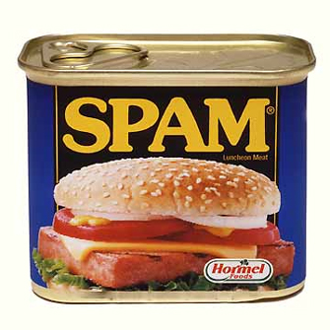
Example: Spam filter
Be careful what you are optimizing. Some measures (typically of Type 4) become dysfunctional when you are optimizing them
phrase P/R/F e.g. in Named Entity Recognition
readability measures
Accuracy of a spam filter
correctly classified as “spam/no spam”
what is the distribution of spam vs. non-spam?

Slide 62
Example: Named entity recognition
Sequence P/R/F, e.g. in Named Entity Recognition, Chunking, etc.
John_{_PER} studied_{_O} at_{_O} the_{_O} Johns_{_ORG} Hopkins_{_ORG} University_{_ORG} before_{_O} joining_{_O} IBM_{_ORG}.
Example tagging 1:
John_{_PER} studied_{_O} at_{_O} the_{_O} Johns_{_PER} Hopkins_{_PER} University_{_ORG} before_{_O} joining_{_O} IBM_{_ORG}.
3 Positives: John (PER), Johns Hopkins University (ORG), IBM (ORG)
2 FPs: Johns Hopkins (PER) and University (ORG)
1 FN: Johns Hopkins University (ORG)
F(PER) = 0.67, F(ORG) = 0.5
Example tagging 2:
John_{_PER} studied_{_O} at_{_O} the_{_O} Johns_{_O} Hopkins_{_O} University_{_O} before_{_O} joining_{_O} IBM_{_ORG}.
3 Positives: John (PER), Johns Hopkins University (ORG), IBM (ORG)
0 FP
1 FN: Johns Hopkins University (ORG)
F(PER) = 1.0, F(ORG) = 0.67
Optimizing phrase-F can encourage / prefer systems that do not mark entities
most likely, this is bad

Slide 63
Multi-label evaluation
Precision, recall, and F1-measure are calculated with respect to a single class.
How can we evaluate the whole classification result?
Calculate the measures for each class.
Calculate the weighted average over all classes (example: F₁ = 0.66).
The weight is determined by the number of test instances in the class.
Predicted Label
 | DET | N | V | ADJ
DET | 10 | 0 | 0 | 0
N | 0 | 7 | 6 | 3
V | 0 | 1 | 5 | 1
ADJ | 0 | 2 | 0 | 3
True Label
Notes:
Als Übung für zu Hause:
Det = P 1 R = 1 F = 1
N: P = 7/10 R = 7/16 F = 0.54
V: P = 5/11 R = 5/7 F = 0.55
ADJ: P = 3/7, R = 3/5 F = 0.5
Instances = 10 + 7+6+3+1+5+1+2+3 = 38
(10/38 * 1 + 16/38 * 0.54 + 7/38 * 0.55+ 5/38 * 0.5) = 0.66
predicted= [1,1,1,1,1,1,1,1,1,1,2,2,2,2,2,2,2,2,2,2,3,3,3,3,3,3,3,3,3,3,3,4,4,4,4,4,4,4]
actual = [1,1,1,1,1,1,1,1,1,1,2,2,2,2,2,2,2,3,4,4,3,3,3,3,3,2,2,2,2,2,2,4,4,4,3,2,2,2]
f1_score(actual, predicted, average='weighted')

Slide 64
Percent reduction of error
80% accuracy = 20% error
Your model increases accuracy from 80% to 90% compared to baseline
error reduced from 20% to 10%
50% reduction in error
improvement from 99.90% to 99.99%
90% reduction in error
improvement from 50% to 75%
50% reduction in error
Notes:
Hört sich oft besser an

Slide 65
RMSE
[Root]?[Mean|Absolute][Squared]?Error
the difference between the predicted and actual values
requires a numeric interpretation of labels
Algorithms (e.g. those in Weka) typically optimize these
possible mismatch between optimization objective and evaluation measure
Notes:
is confusing class 3 with class 1 worse than confusing class 3 with class 2?

Slide 66
Missing values
Missing values for features are a critical issue for many algorithms
Decision trees cannot compute an output, if a value for a critical node is missing.
→ Replace missing values with mean or median of feature.
Naïve Bayes classifiers returns a class probability of 0, if the frequency for one feature is 0. → Apply smoothing algorithm.
Many different smoothing algorithms exist. Most simple one: Add-one-smoothing (every feature occurs at least once).

Slide 67
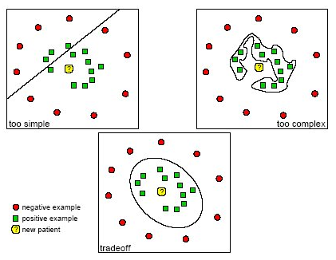
Underfitting & overfitting
Underfitting
the model is not capable of learning the (complex) patterns in the training set
use better features or classifier
Overfitting
The model perfectly learns to classify the training data, but has bad generalization ability → high test error
results in useless model for unseen data
typical for small sample sizes combined with powerful models

Slide 68
Ensemble: combining classifiers
Different machine learning algorithms have varying performances on different types of problems.
Idea: combine several different weak learners into a single strong learner.
Several possible combination schemes:
weighted sum of independent learners
cascading: next learner is trained on features AND output of previous learners
...
This is even more trial and error, but can result in an optimization of the performance if computational complexity at runtime is not an issue.

Slide 69
Summary
Evaluation metrics
accuracy, precision, recall, f-measure
root mean squared error (RMSE)
percentage reduction
Missing values
Underfitting, Overfitting
Ensemble learning

Slide 70
Typical machine learning workflow
Define the problem & collect data
instance, target variable/labels, collect and label/annotate data
Split data in train / validation (development) / test (evaluation)
Define features
Pick a learning algorithm
train model on training set
optimize/set model hyperparameters (e.g. number of instances / leaf, use pruning, …) according to performance on validation data
Test final model on held-out data
Use model on unseen data, visualize results, analyze errors
Next Lecture

Slide 71

Take-home messages
Supervised learning
based on a set of labeled examples (x, f(x)) learn the input-output mapping f(x)
factors for successful machine learning
much data & good features & well-suited learning algorithm
ML workflow
problem definition
feature engineering; experimental setup /train, validation, test …/
selection of learning algorithm, (hyper)parameter tuning, training a final model
predict unseen examples & fill tables / draw figures for the paper - test
Careful with
data representation (i.i.d, comparability, …)
experimental setup (cross-validation, blind testing, …)
data size and algorithm selection (+ overfitting, underfitting, …)

Slide 72
Readings
Mandatory
Russel & Norvig: Chapter 18 Learning from Examples, p.693-707
Please answer the following questions in Moodle:
Was versteht man unter Occam’s razor?
Wie kann ein Lernalgorithmus damit umgehen, wenn für eine Instanz ein Feature nicht erhoben werden konnte (N/A Wert, missing values)?
Wie können bei Entscheidungsbäumen auch kontinuierliche numerische Variablen verwendet werden?

